Slide 1
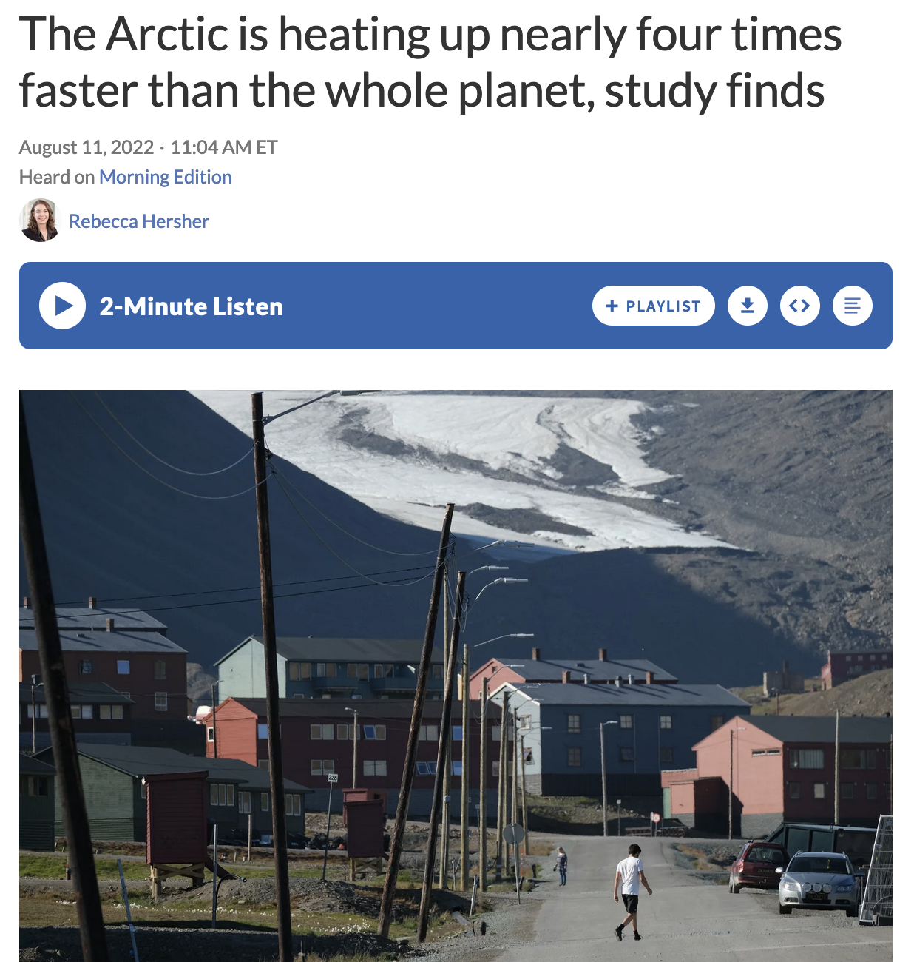
Warming in the Arctic (NPR)
https://www.npr.org/2022/08/11/1116608415/the-arctic-is-heating-up-nearly-four-times-faster-than-the-rest-of-earth-study-f

Slide 2
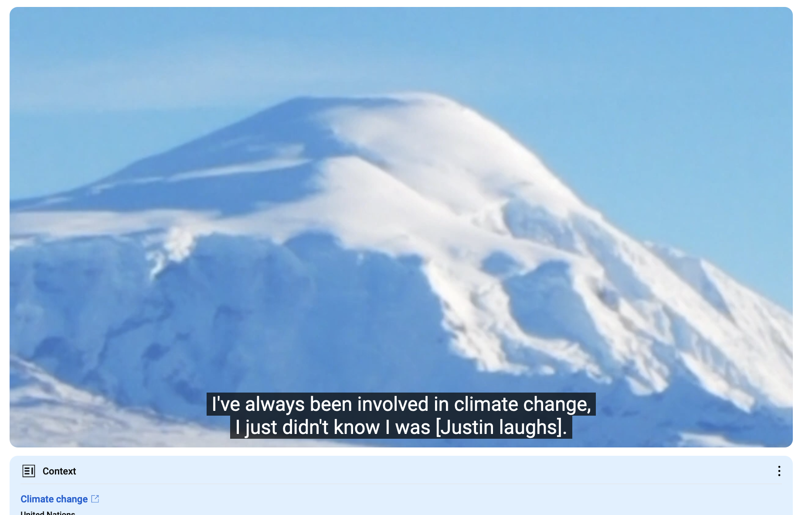
Wilson Justin, Althsetnay Clan (Nabesna)
In the middle (reference to climate change): https://youtu.be/gBBffAtqMsc?t=462
From the beginning of the recording: https://youtu.be/gBBffAtqMsc

Slide 3
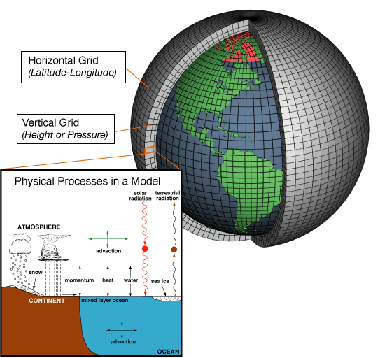
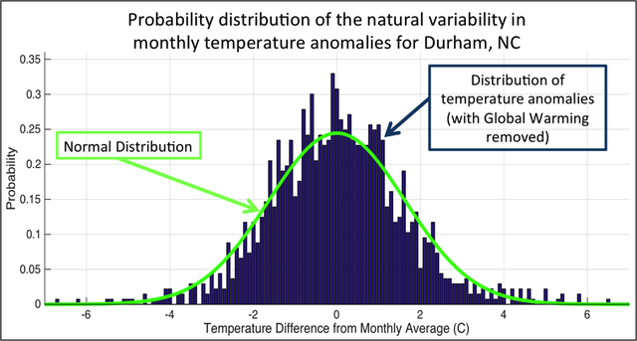
What exactly are we trying to represent when we model climate?
We’ve seen a lot of geographical variability in the observational record (EdGCM). How about temporal variability at a given location?

Slide 4
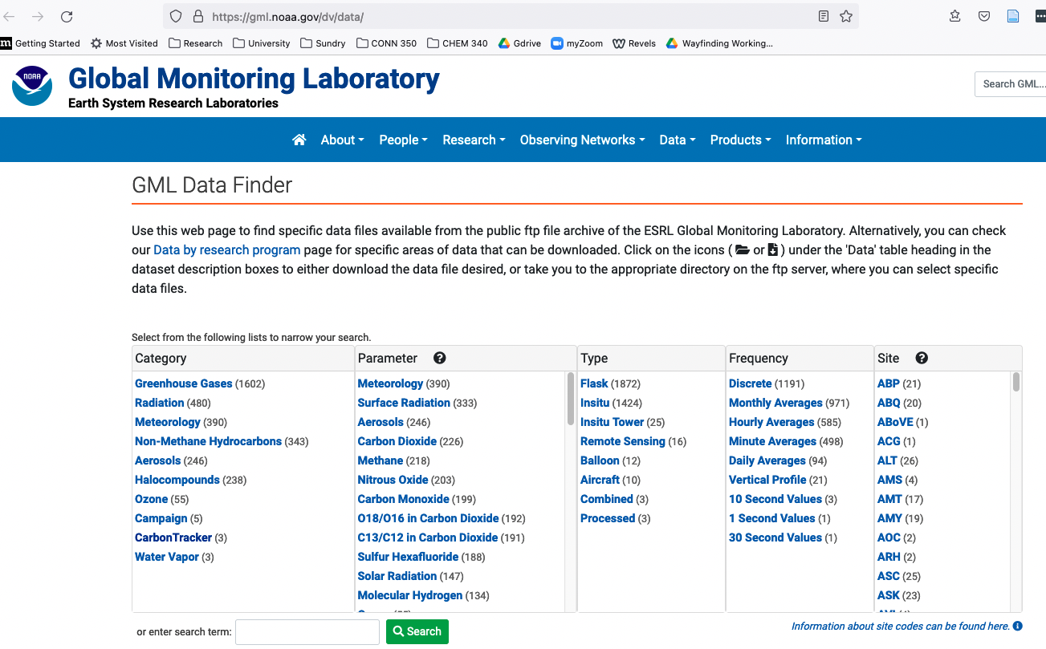
NOAA archive
https://gml.noaa.gov/dv/data/, Navigate to Meteorology, Hourly Averages, BRW
Data
Metadata

Slide 5
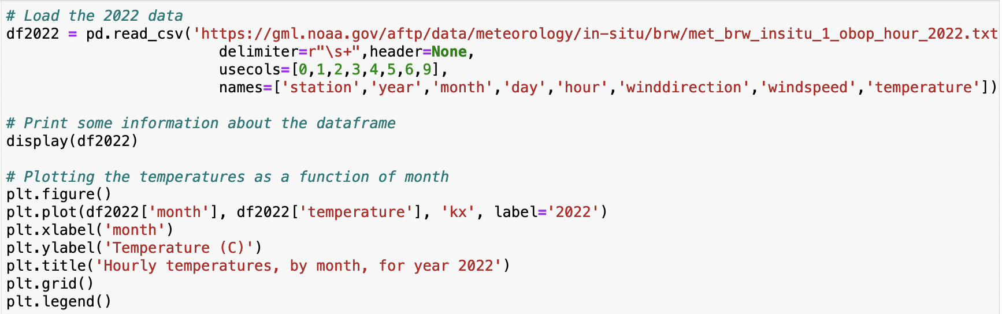
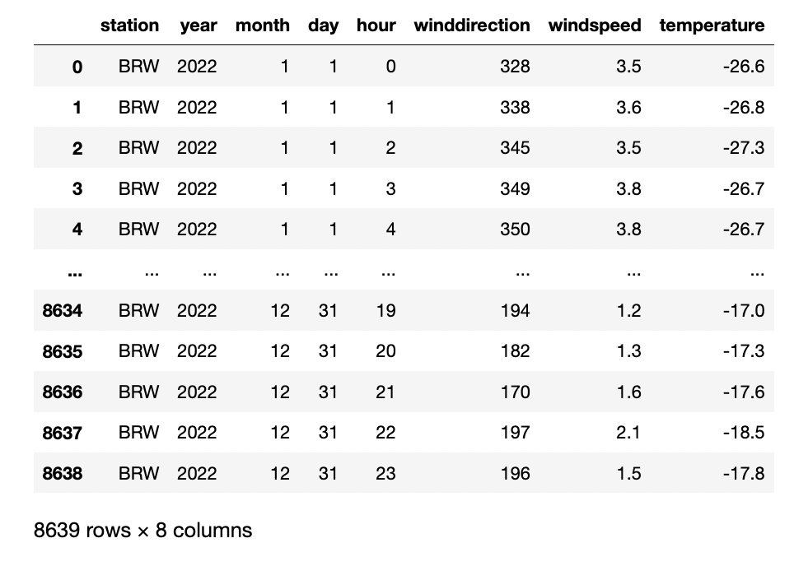
PANDAS loads and displays that kind of data as a dataframe

Slide 6
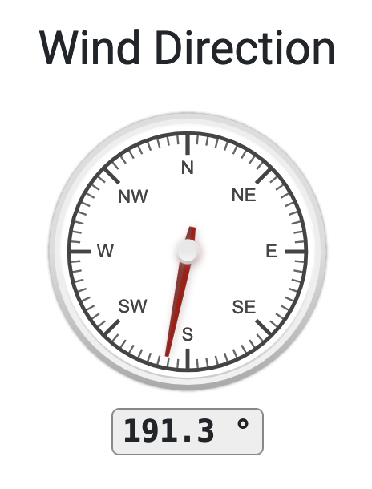
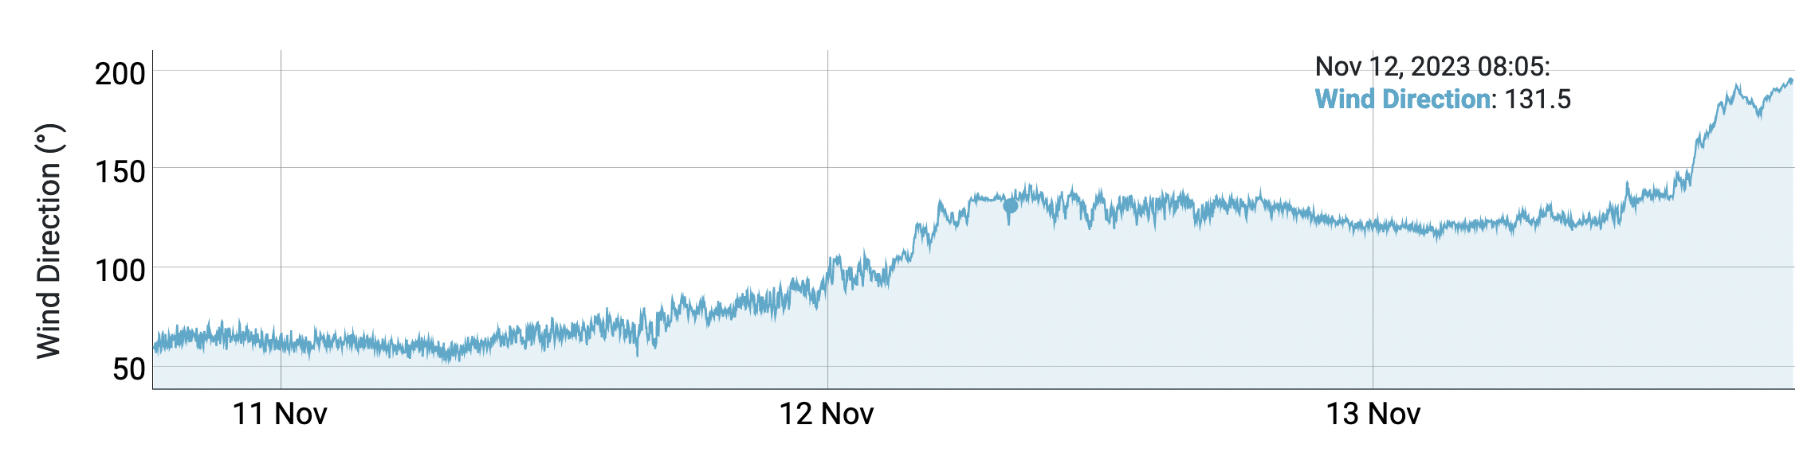
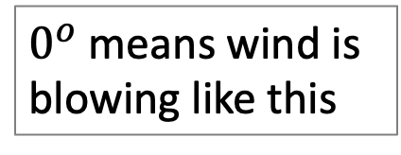
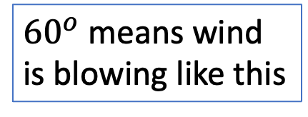
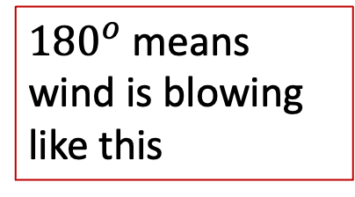
A note about the wind: it’s referenced from winds coming from the north
$0^{o}$ means wind is blowing like this
${180}^{o}$means wind is blowing like this
${60}^{o}$ means wind is blowing like this

Slide 7
Python can graph selected parts of the dataframe

Slide 8
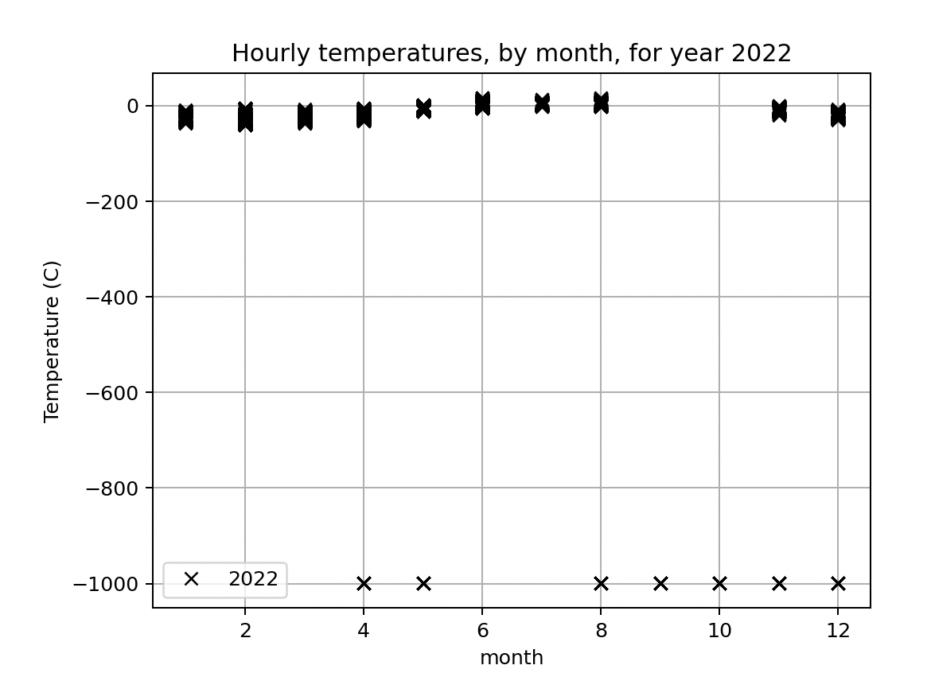
What you download generally needs some quality control

Slide 9
What you download generally needs some quality control
Good data
Bad data

Slide 10
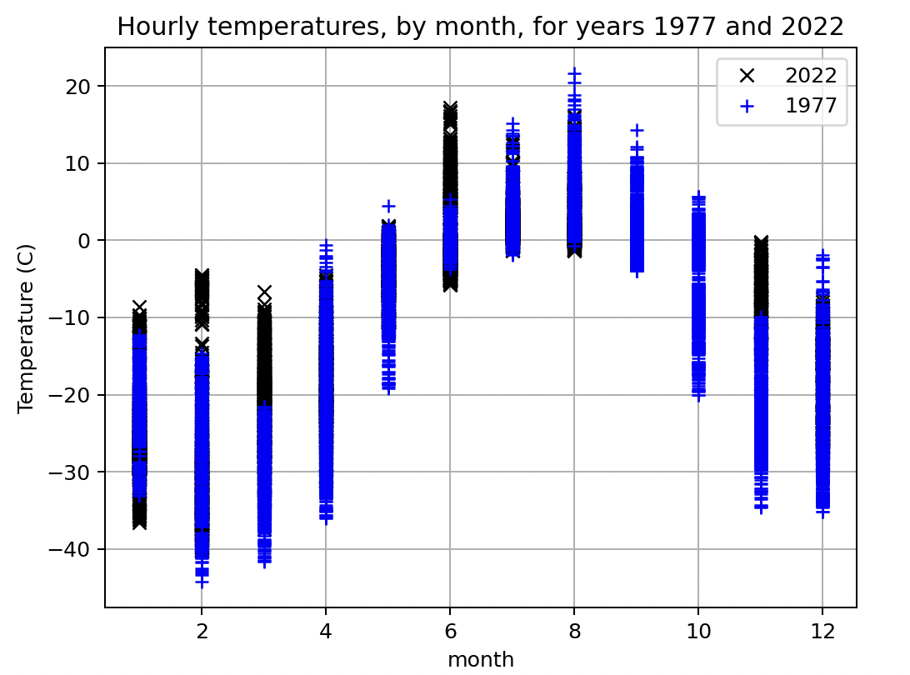
What you download generally needs some quality control
Good data
Bad data

Slide 11
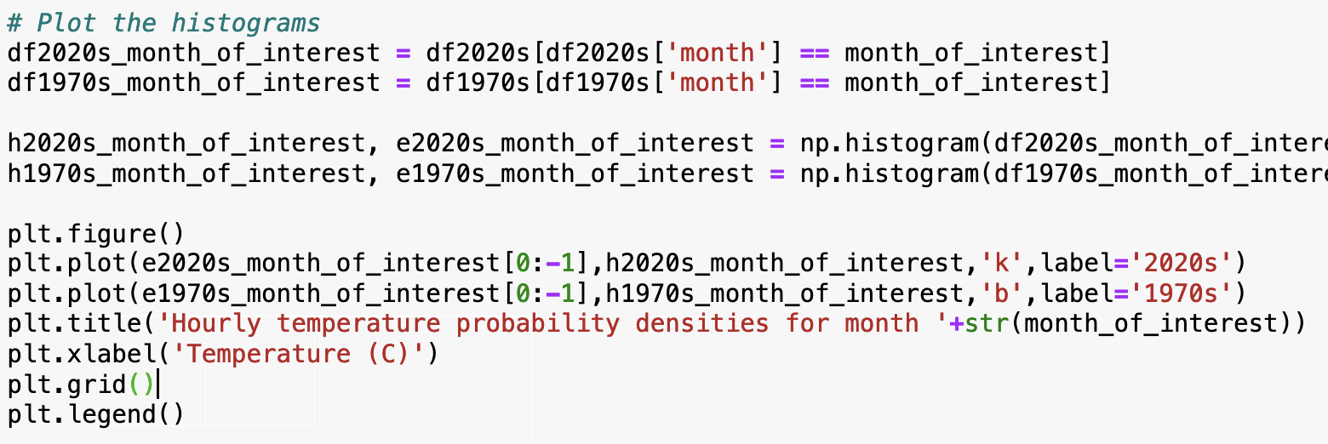
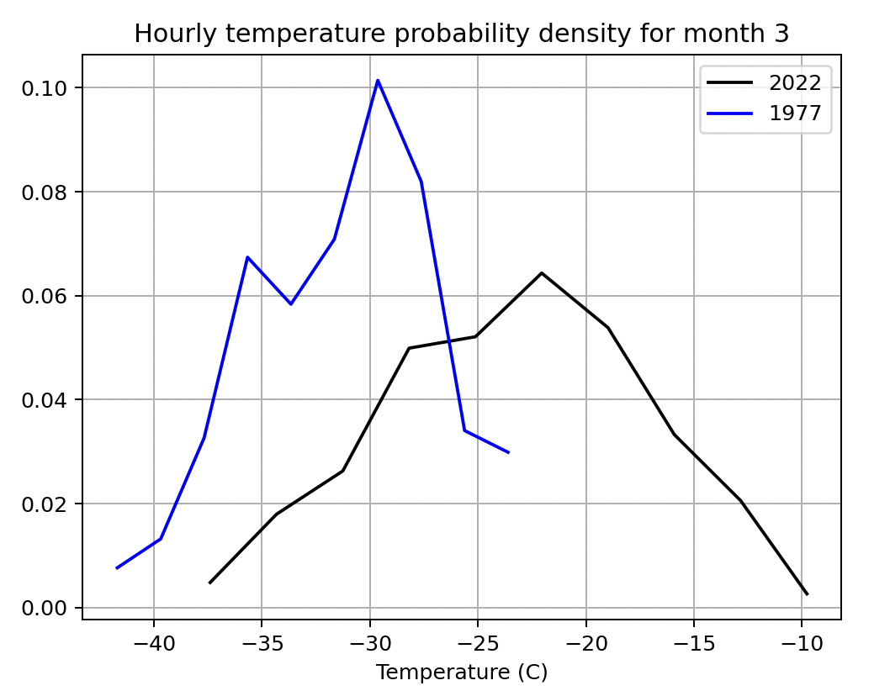
Once you have got rid of the bad data, you can do some statistics

Slide 12
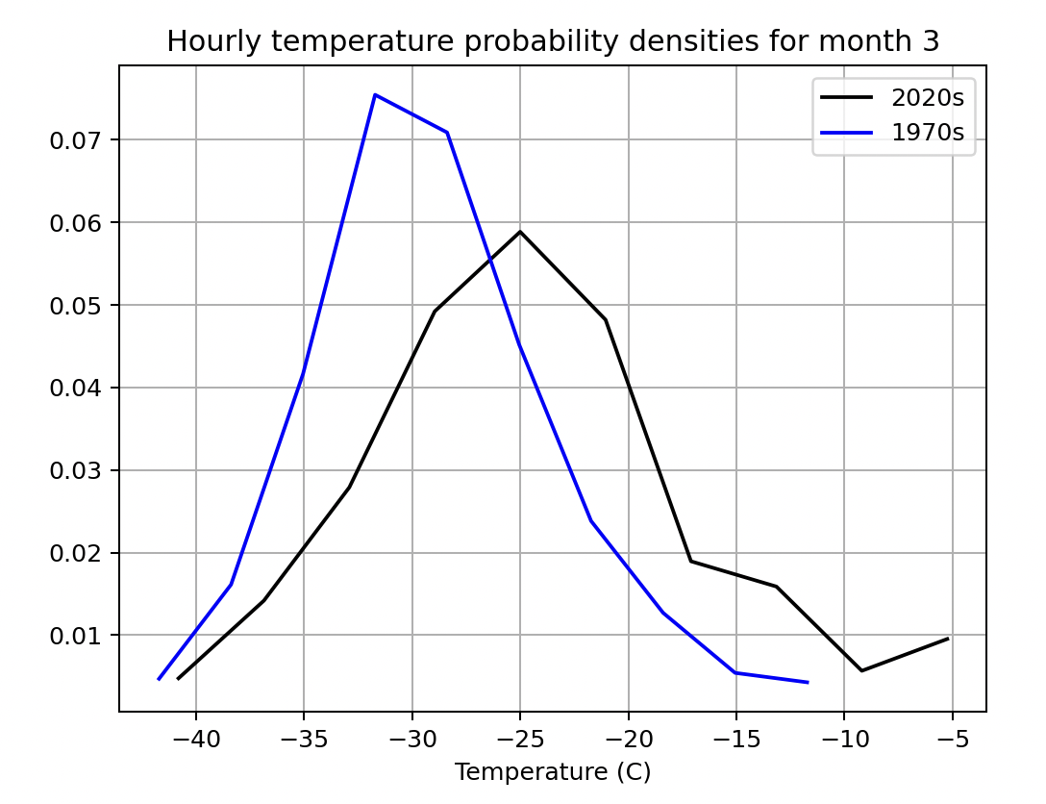
You can see what averaging over more years can do for you
1-year datasets
3-year datasets

Slide 13
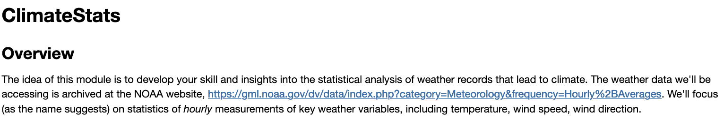
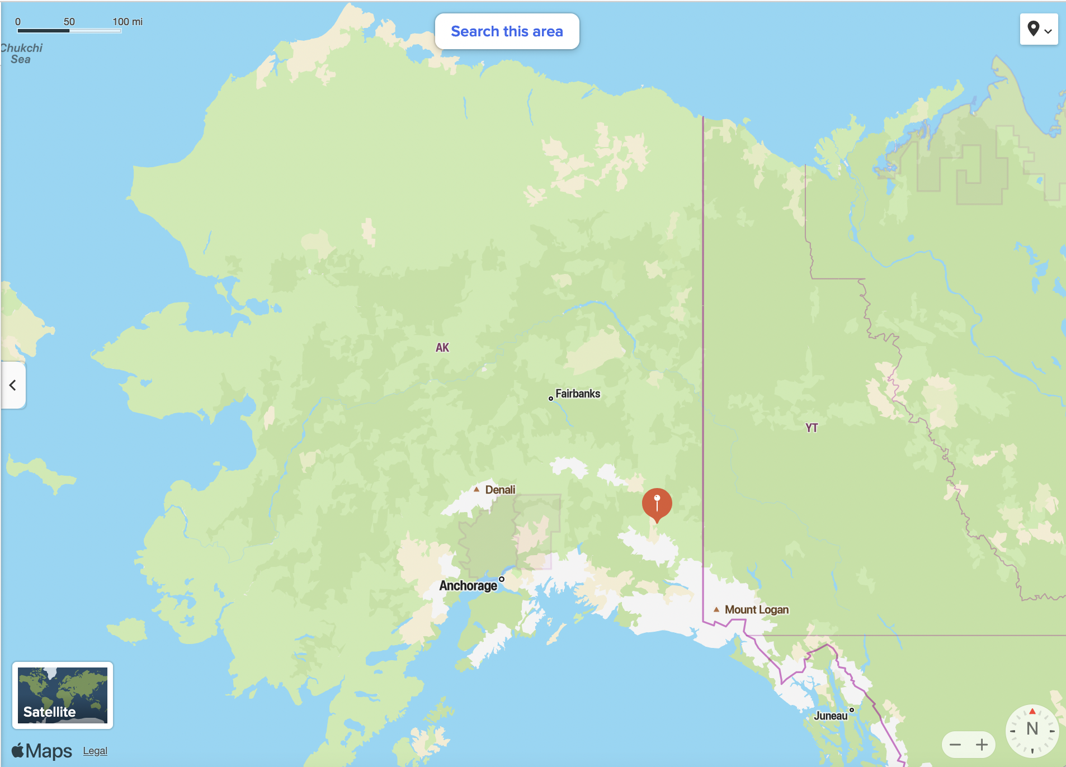
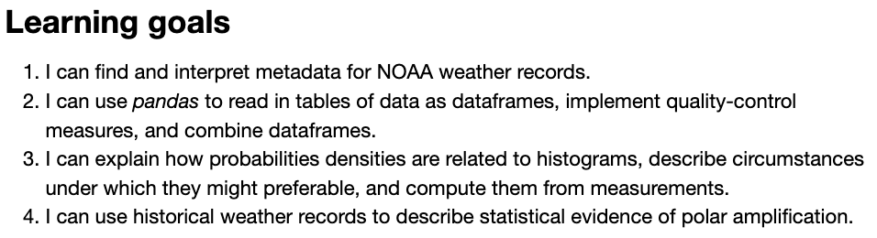
The CGI associated with this

Slide 14
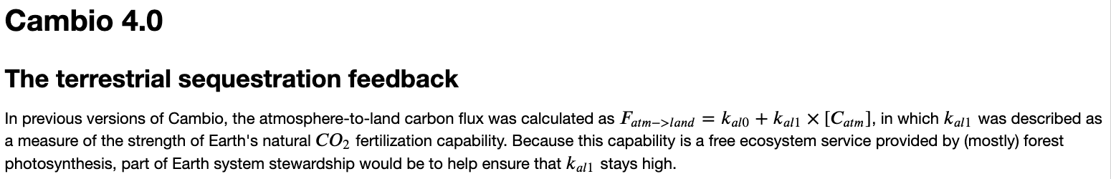
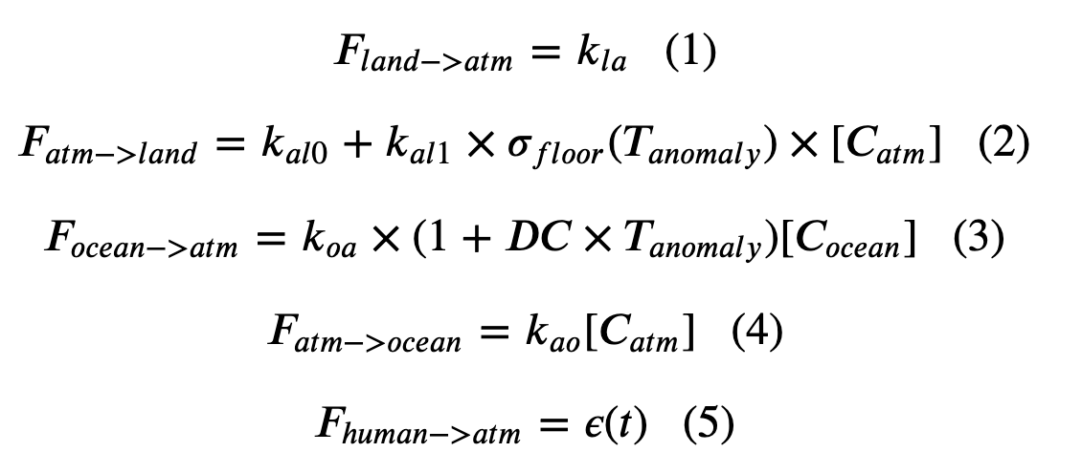
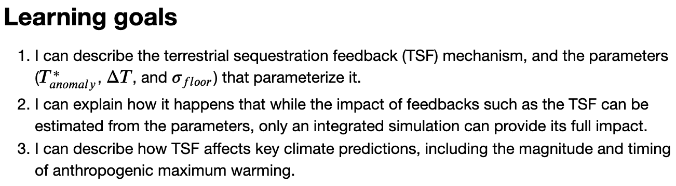
Also, the last CGI of the semester

